Slide 1


The Oxford Metro: Learning from Europe
All Party Parliamentary Light Rail Group

Slide 2
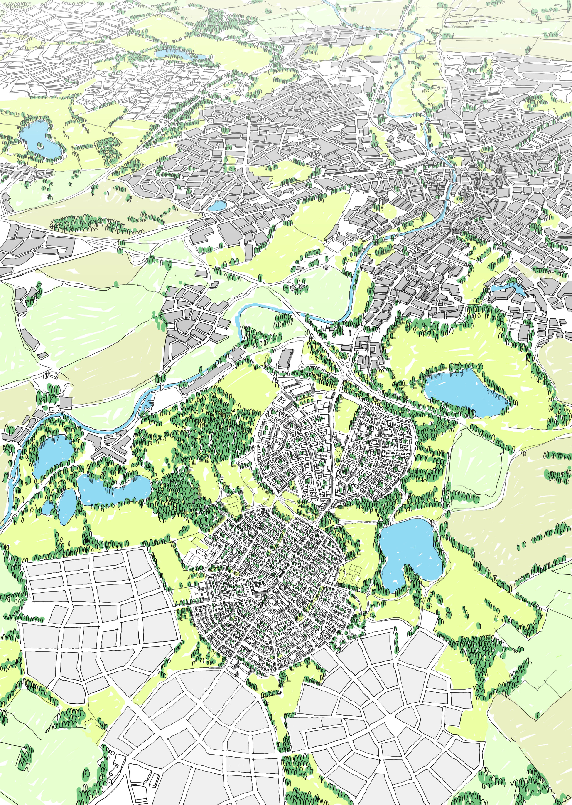

BEYOND UXCESTER
GARDEN CITY: what next?

Slide 3
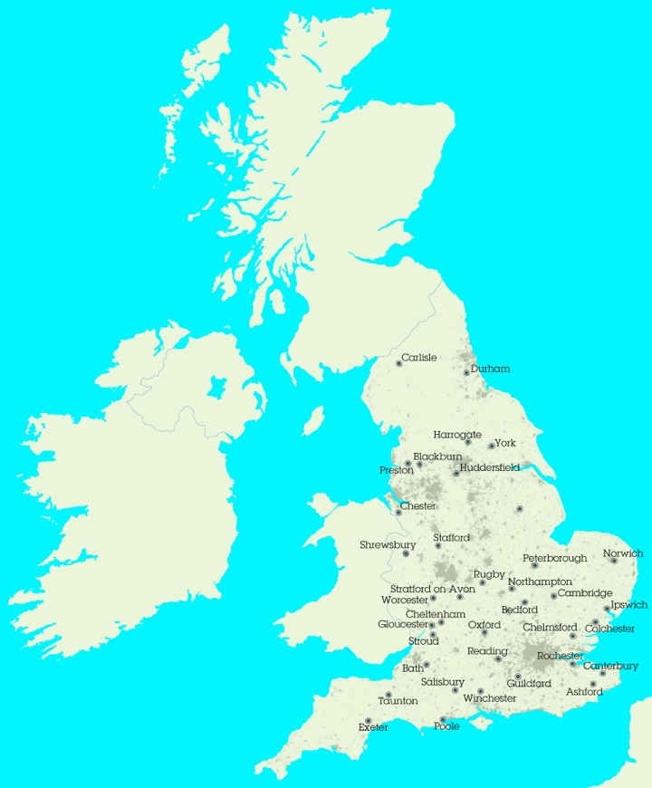

Slide 4
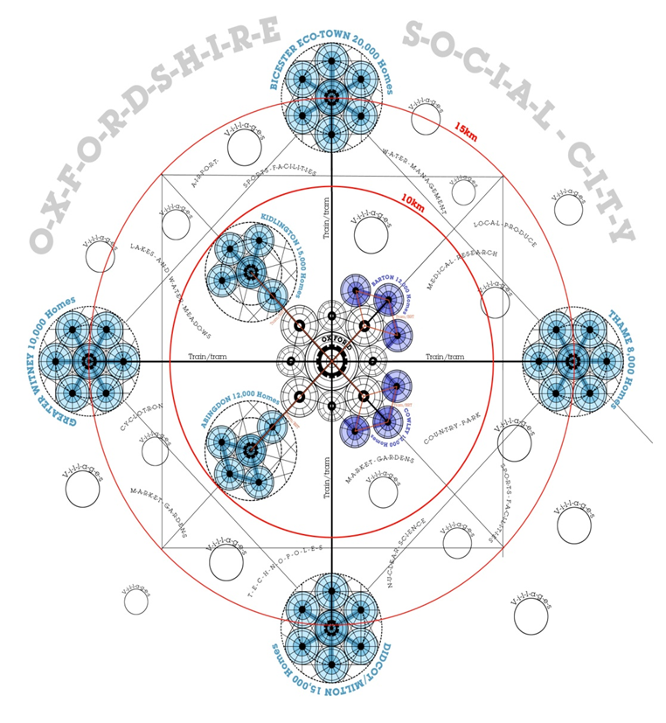
URBED tested the ideas out in Central Oxfordshire

Slide 5
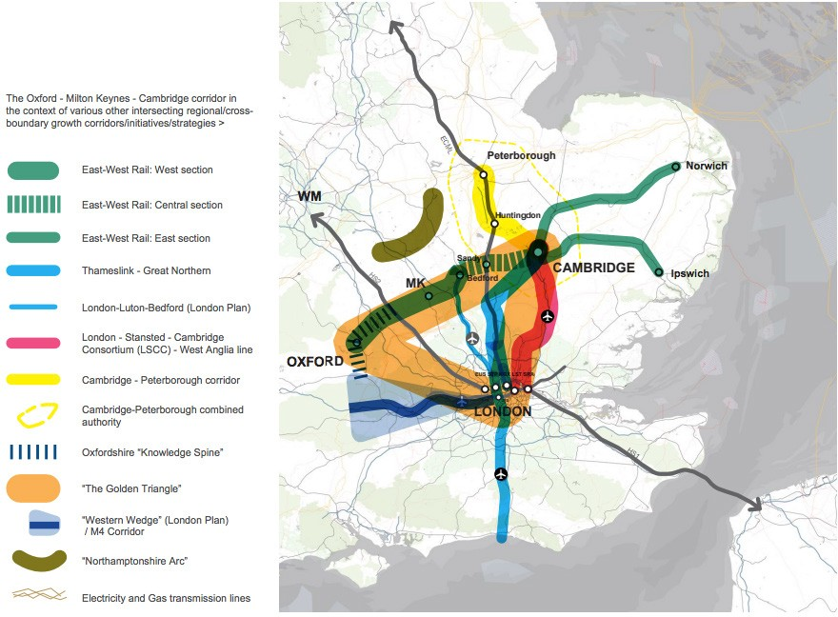
The Arc of Opportunity stretches to London
Source: Fifth Studio for NIC

Slide 6

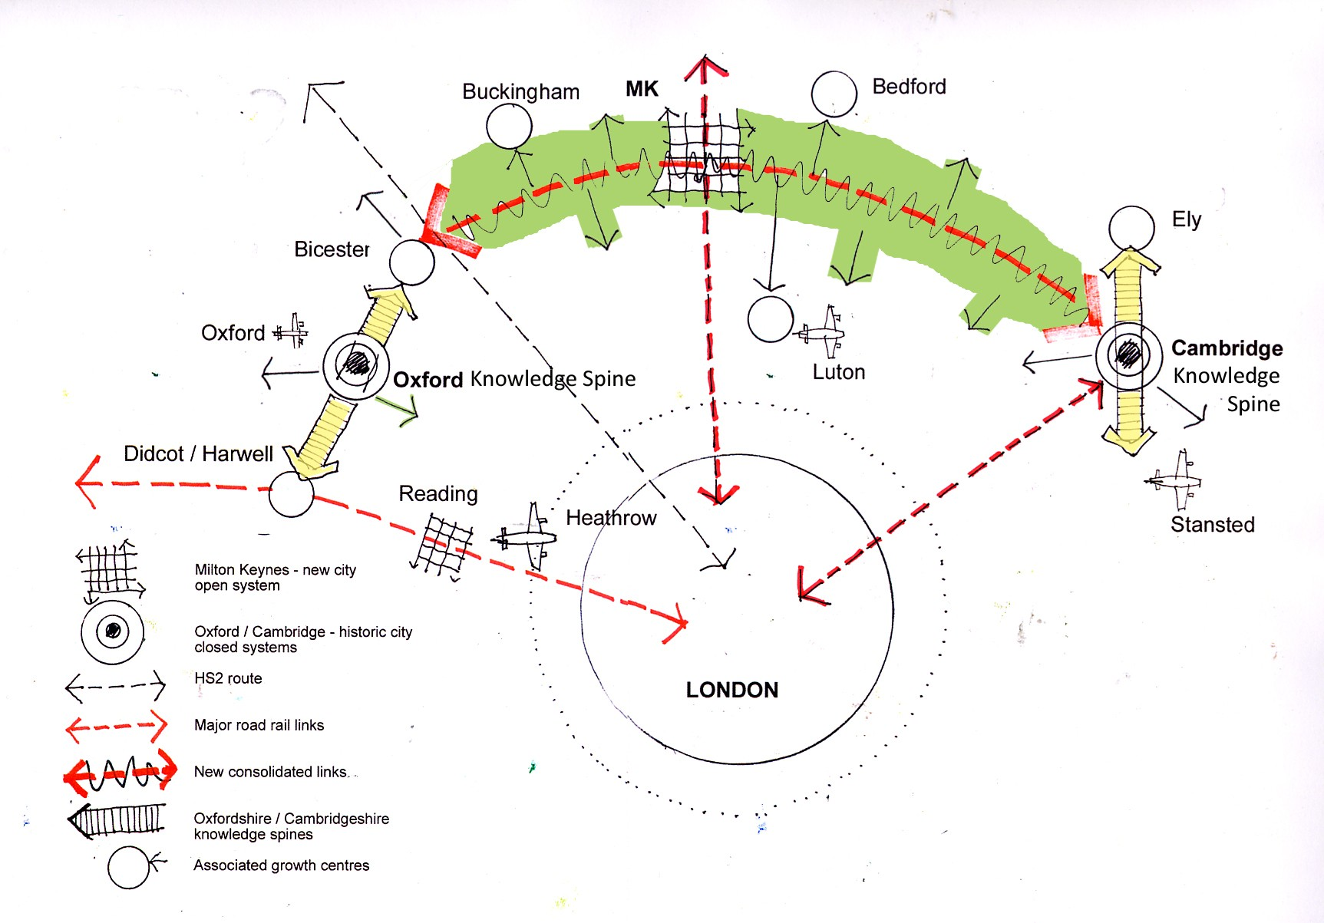
Source: John Rowland Urban Design

Slide 7
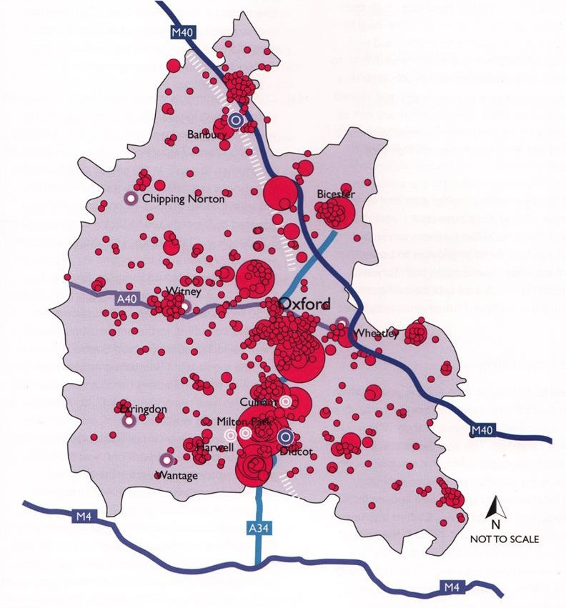
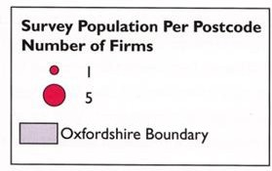
Knowledge based employment forms a spine

Slide 8
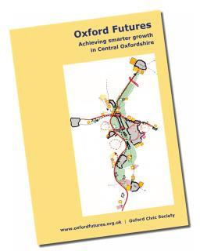
The original Oxford Futures vision

Slide 9
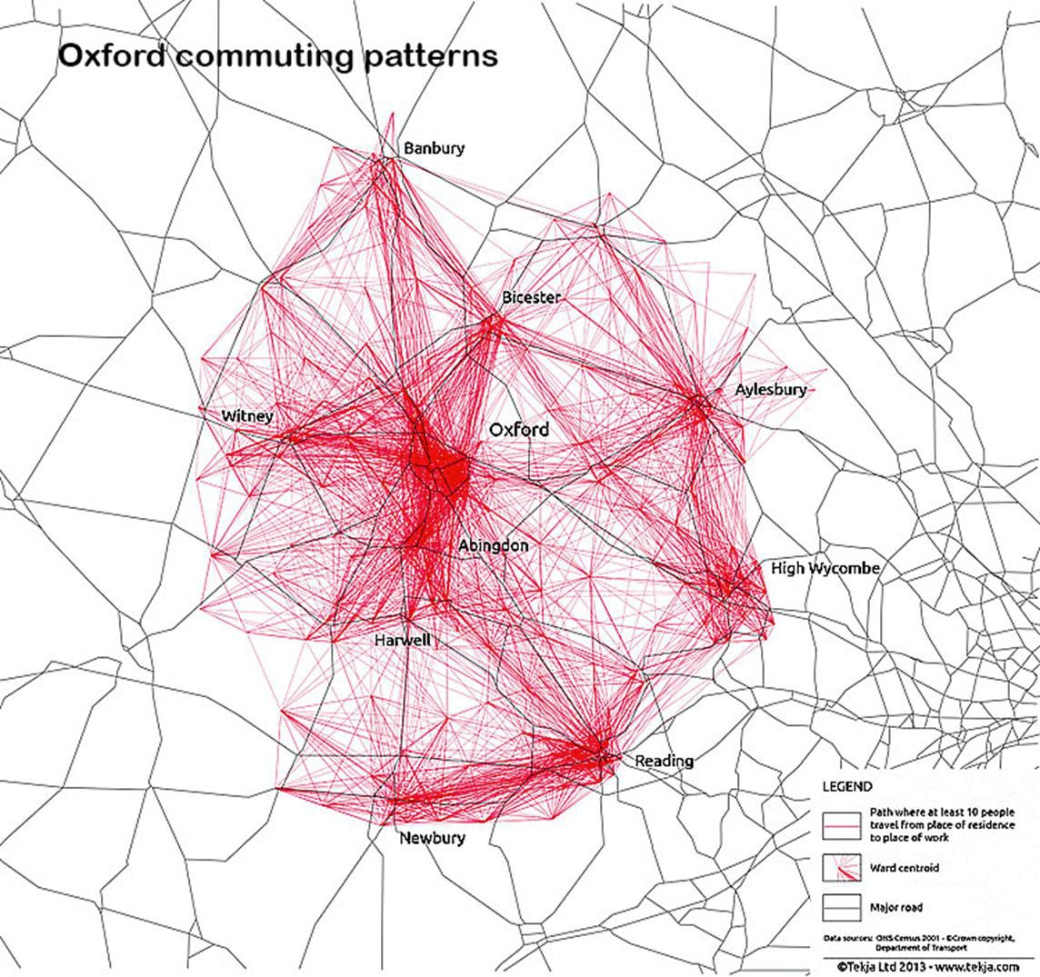
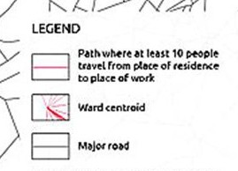
Traffic flows round Oxford to East

Slide 10












Proposals for the Spineline and BRT
Langford Lane
North Kidlington
Bicester Village
Begbroke Hill
Kidlington
P&R A40W Eynsham
Islip
Northern Gateway
Oxford Parkway
Summertown
Oxford
Headington
Botley
P&R A40E Thornhill
P&R A420 corridor
Redbridge
Cowley
Oxford Business Park
BMW Cowley
Blackbird Leys
Oxford Science Park
P&R A34 North Abingdon
Radley
P&R A4074 corridor
KEY
Spine Line with interchange Other local rail with interchange Section subject to study Existing station
New Station
Possible future station Proposed bus rapid transit Existing/planned employment
Possible future employment
Planned housing Possible future housing
Culham
Radley Milton Park Redbridge
Appleford/
North Didcot
Milton Park
Former Power Station
Valley Park
Gt Western Park
Didcot Parkway
Source: Peter Headicar

Slide 11
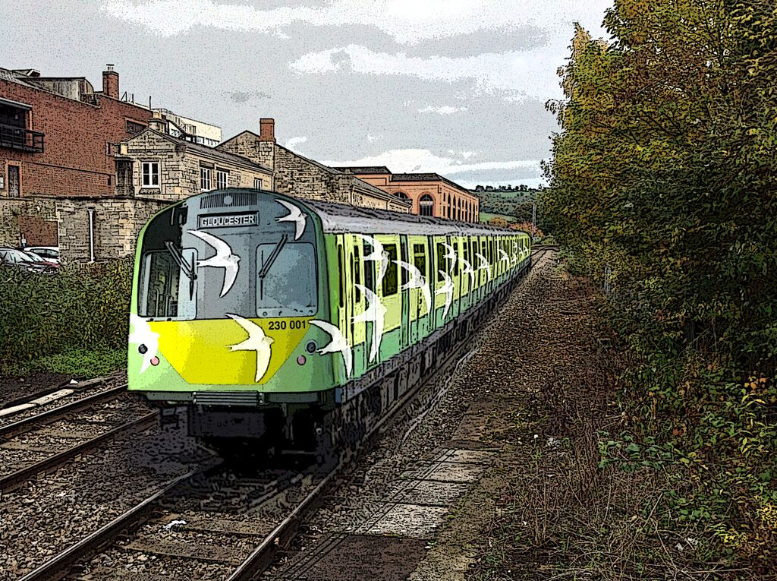

Slide 12
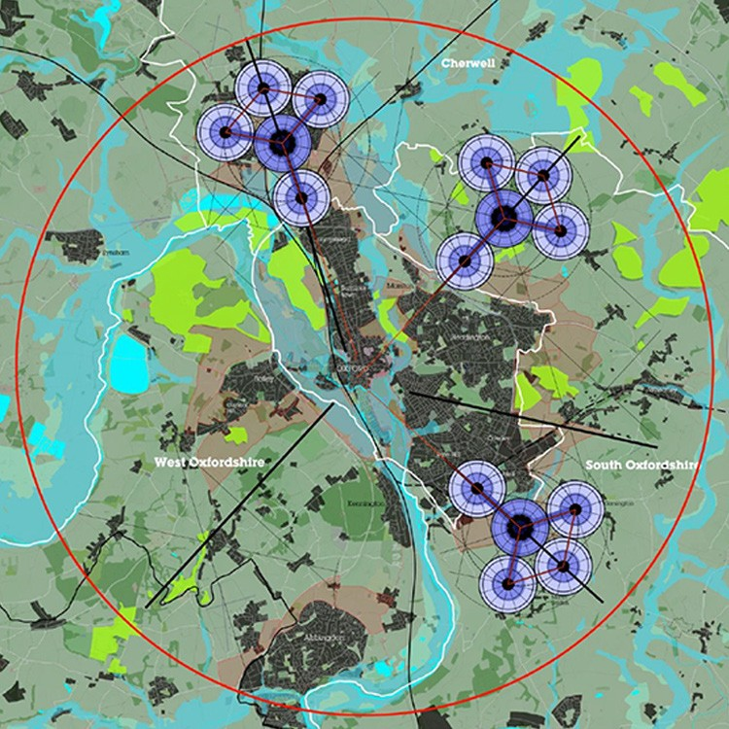
Locations for sustainable growth
Source: 2014 Wolfson Economics Essay winning entry

Slide 13
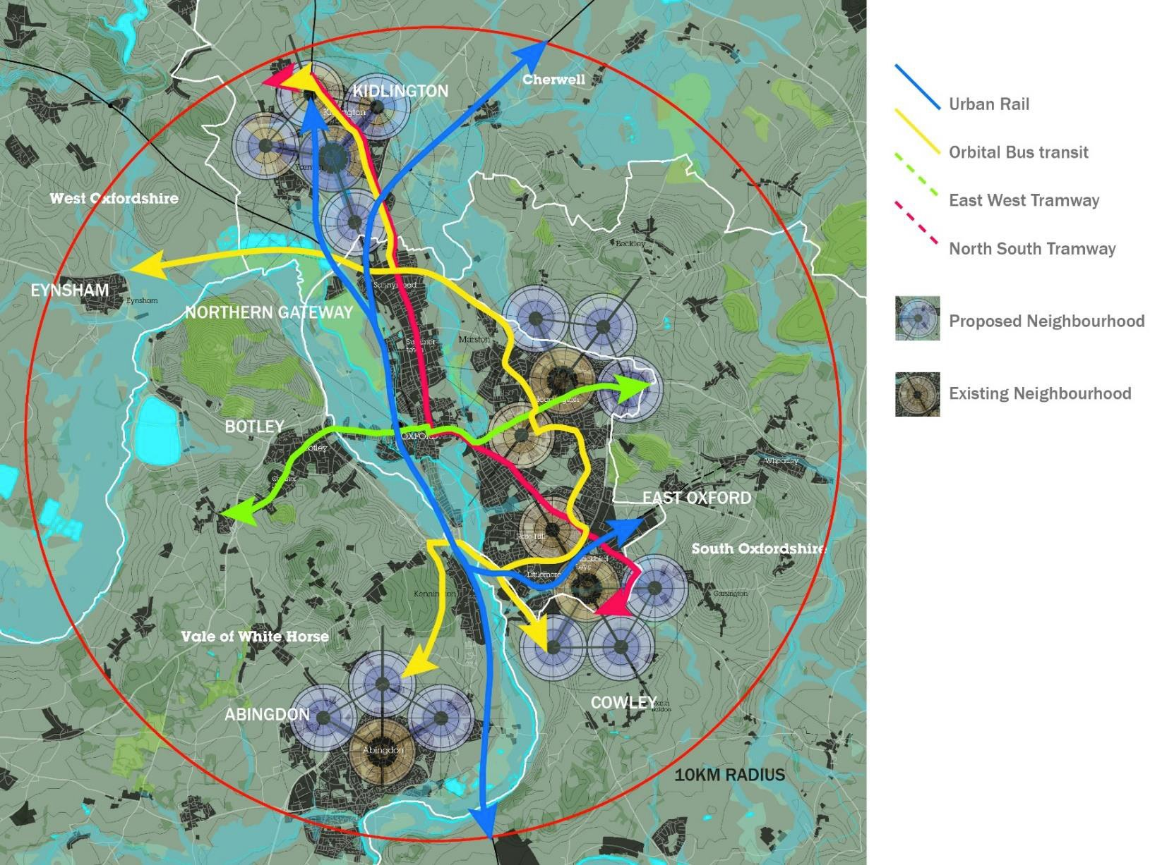
Illustrative plan for the Oxford Metro System
Source: URBED

Slide 14
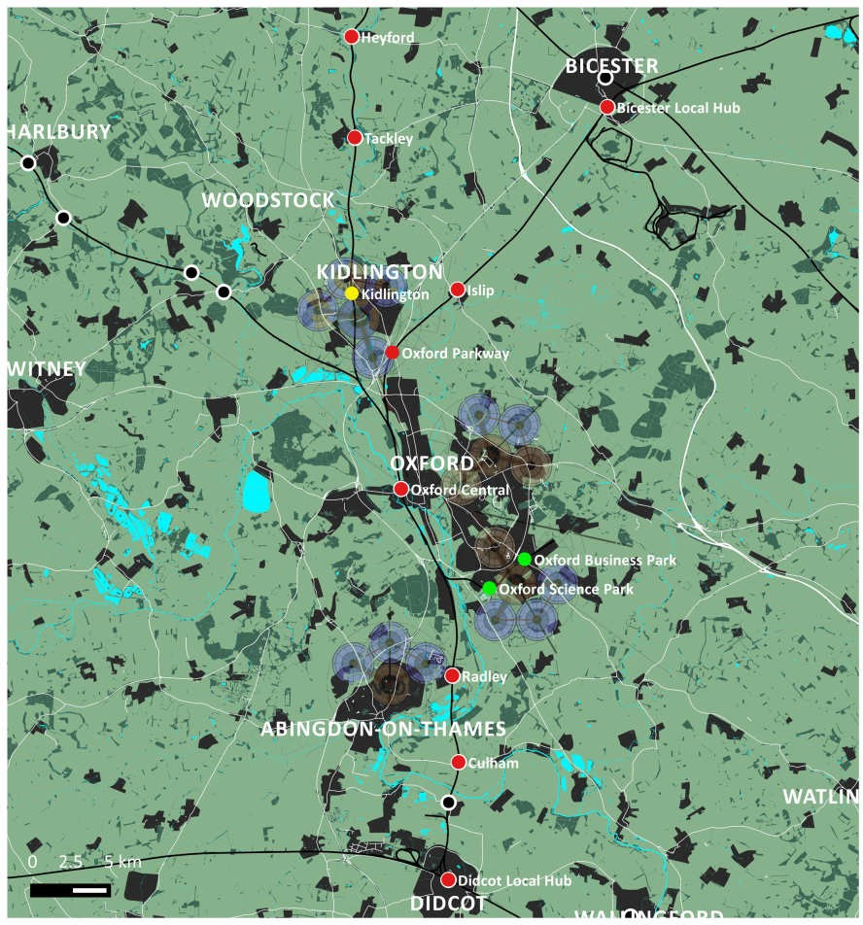
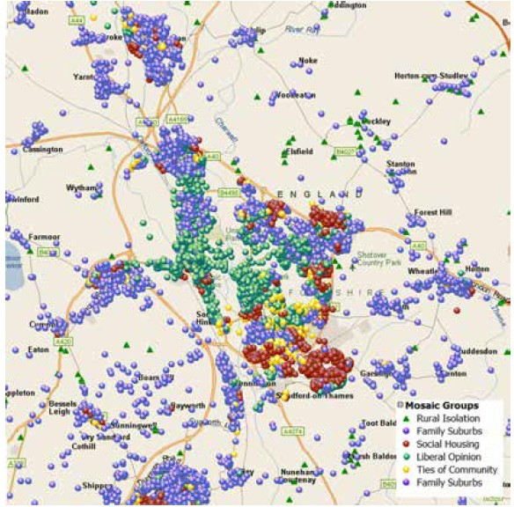

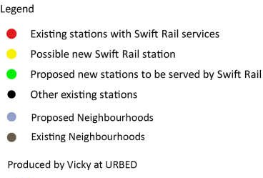
The Spineline would benefit areas that are cut off
Source: URBED and Richard Webber - Experian

Slide 15
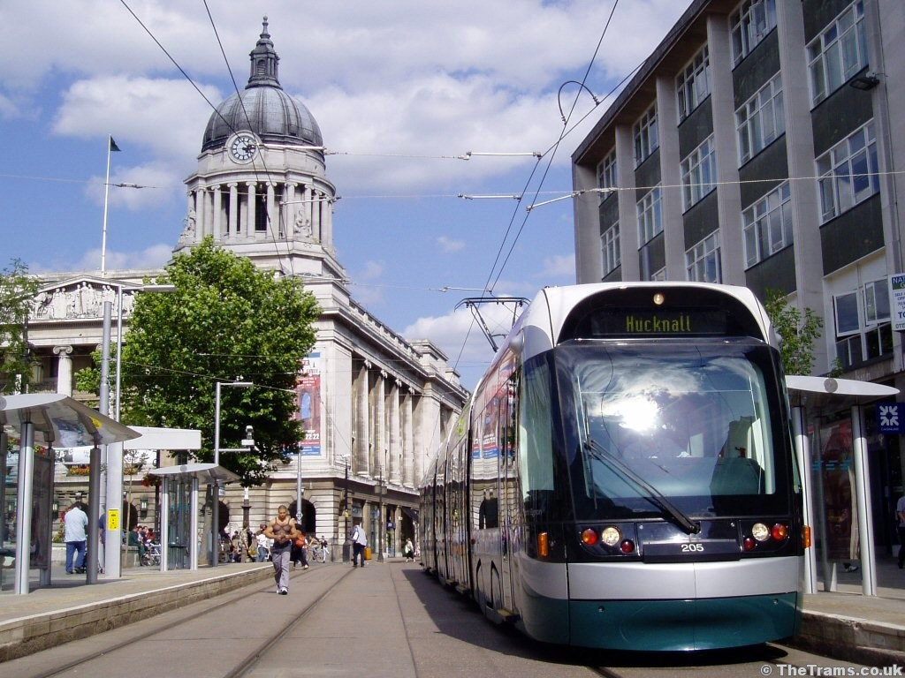
Nottingham Tramlink is a great success

Slide 16
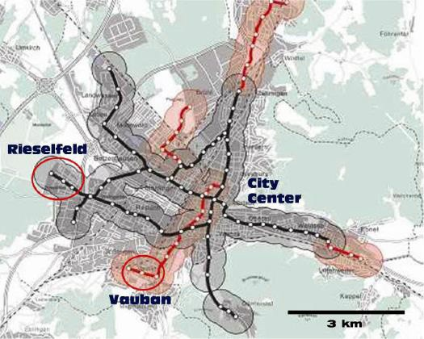
Freiburg is known as the ‘City of Short Distances’

Slide 17
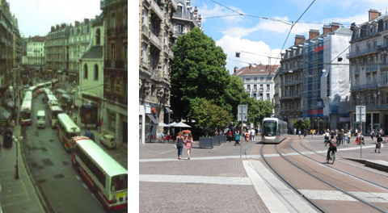
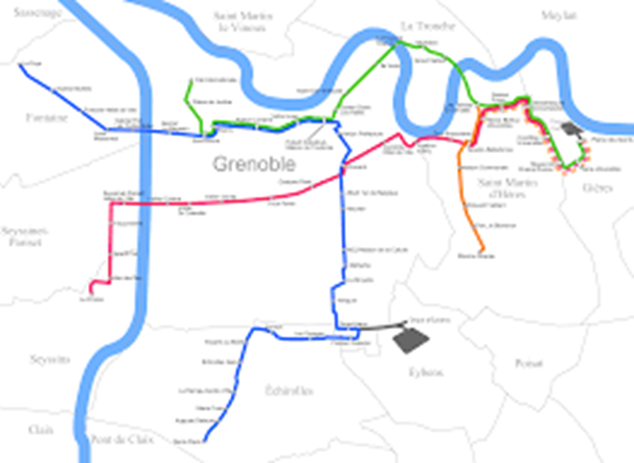
Grenoble’s trams link the main traffic generators

Slide 18
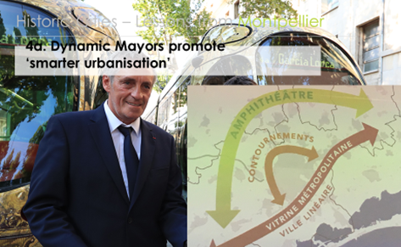
Montpellier’s trams link the city with the sea

Slide 19
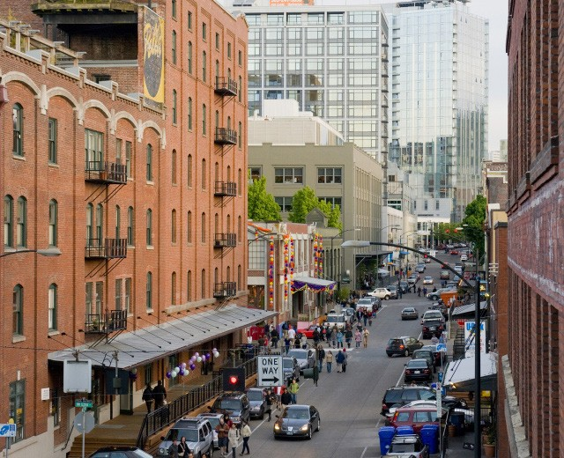
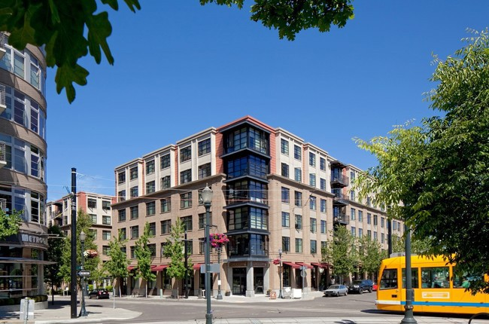
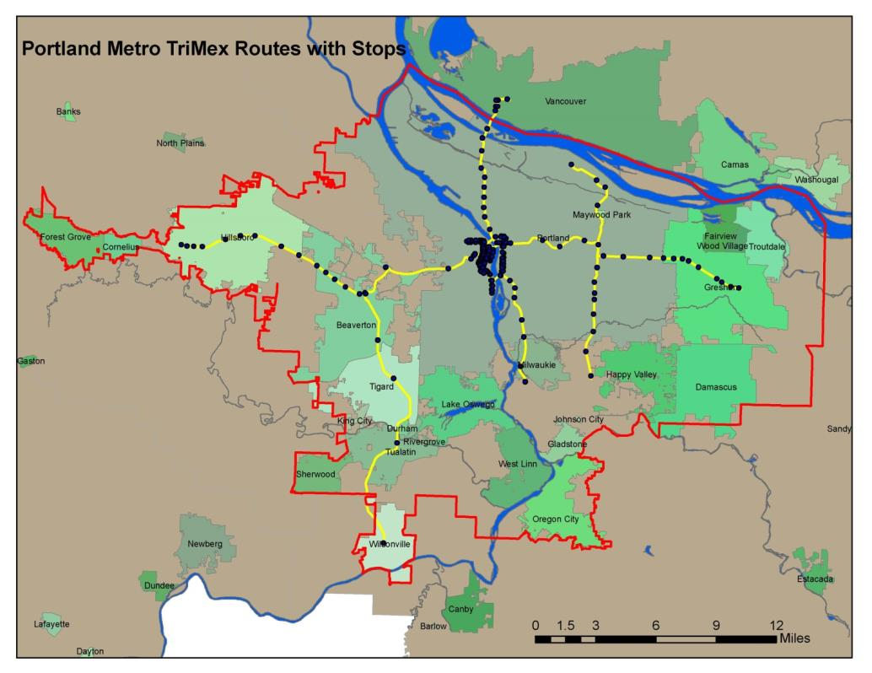
Portland Oregon used tax increment
finance to build its light rail system

Slide 20
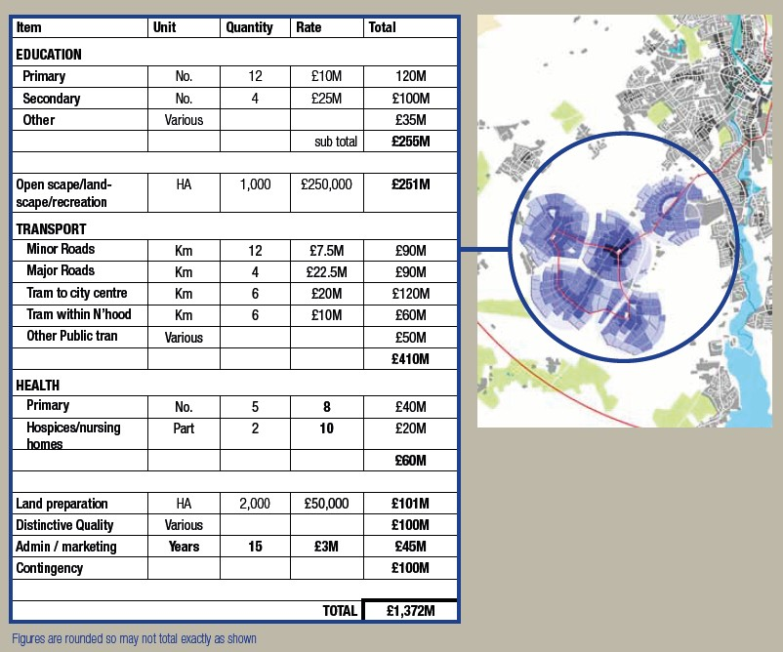
Oxford could use land value
uplift to fund infrastructure
Source: Pete Redman, TradeRisks

Slide 21
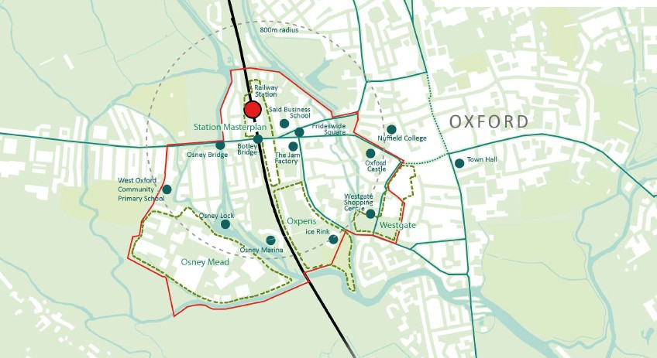
Oxford Central West has
huge potential (200 acres!)
Source: URBED

Slide 22
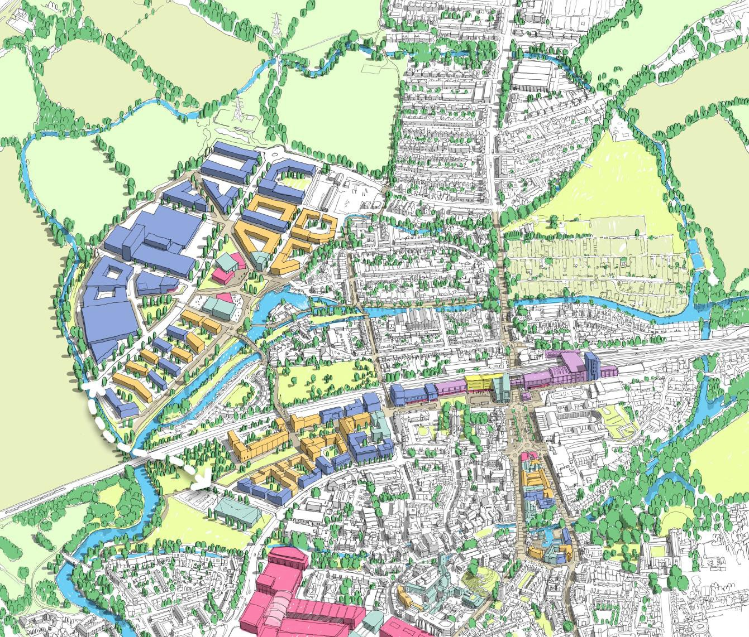
A bridge would open up Osney Mead
and relieve the Botley Road

Slide 23
Land value uplift should cover much of the costs
Potential for land value uplift sharing varies across the country | Stoke-on- Trent | Peterborough | Reading | Sutton
Average open market value £ | 160,000 | 230,000 | 300,000 | 410,000
Density dpha | 30 | 40 | 60 | 120
Affordable housing (AH) % | 10% | 20% | 25% | 30%
Per hectare
Market sales value £pha | 4,200,000 | 7,300,000 | 13,400,000 | 34,500,000
Less
Land acquisition and preparation £pha | 500,000 | 700,000 | 1,700,000 | 4,200,000
All in development cost £pha | 3,700,000 | 5,700,000 | 10,000,000 | 25,400,000
Balance for uplift sharing £pha | - | 900,000 | 1,700,000 | 4,900,000
Source: Pete Redman, Housing Futures

Slide 24
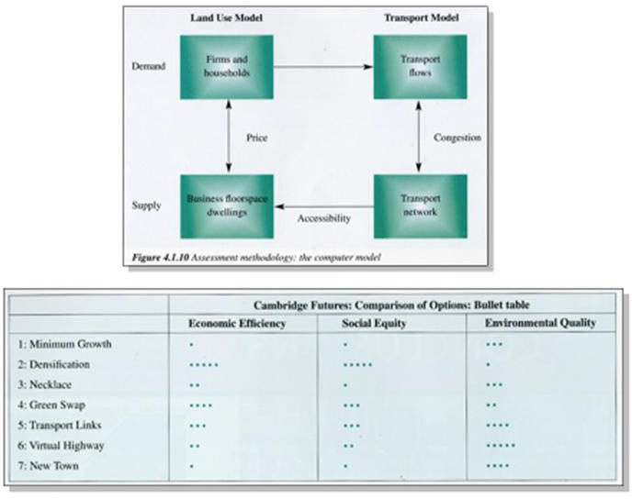
Cambridge Futures used multiple criteria analysis

Slide 25
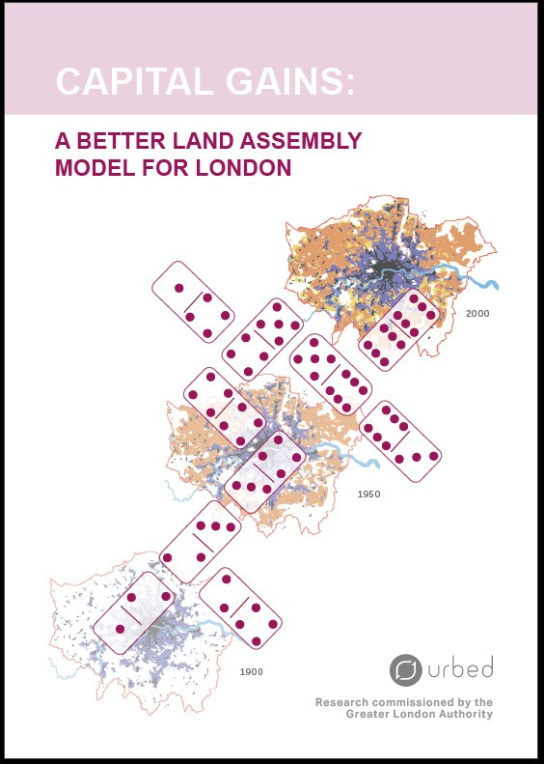
Capital gains could be secured

Slide 26
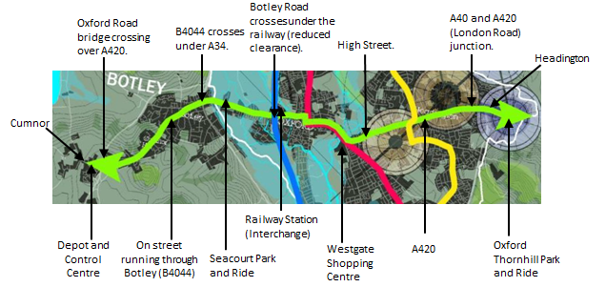
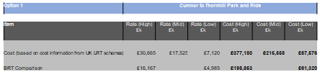
Oxford Tram:
Option 1: Cumnor to Thornhill Park and Ride

Slide 27
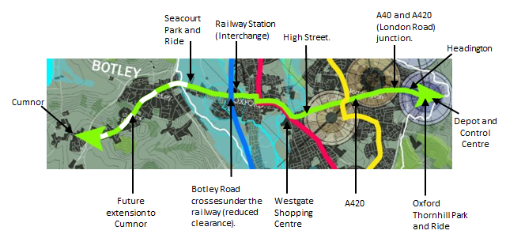
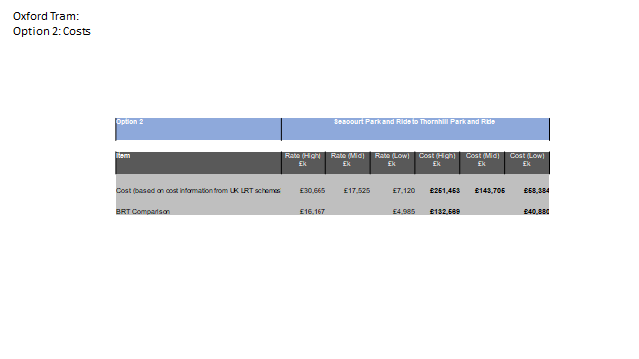
Oxford Tram:
Option 2: Seacourt Park and Ride to Thornhill Park and Ride

