Slide 1
How Can Historic Cities Grow Sustainably?
- The Need For Cambridge Rapid Mass Transit
Councillor Lewis Herbert, Leader - Cambridge City Council
Portfolio Holder - Strategic Planning, C&P Combined Authority
and Vice-Chair, Greater Cambridge Partnership (City Deal)

Slide 2
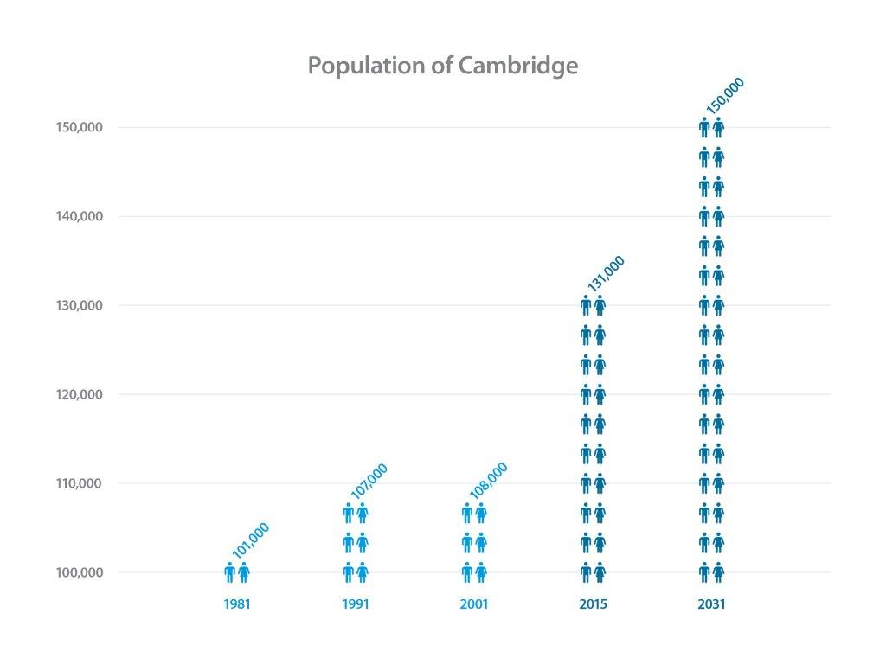
Housing

Slide 3
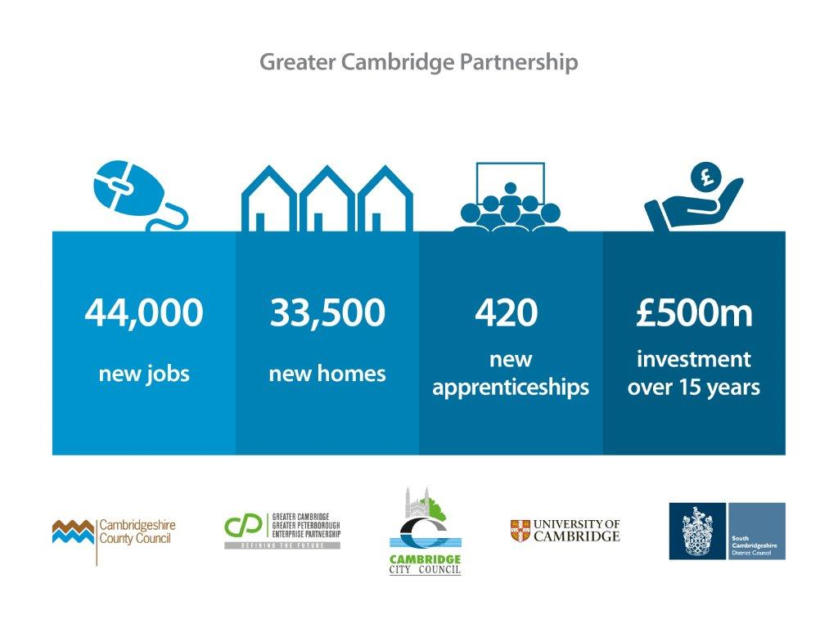
Housing

Slide 4
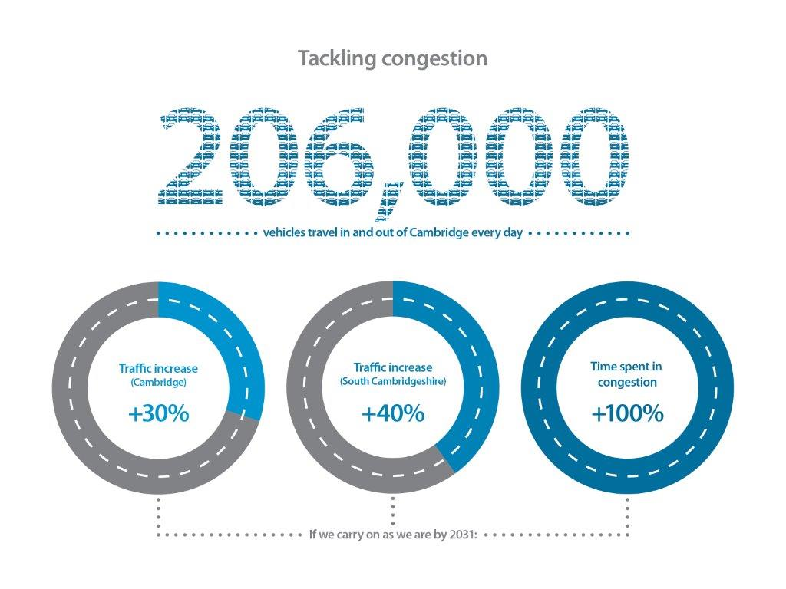
Housing
Notes:
Modal shift

Slide 6


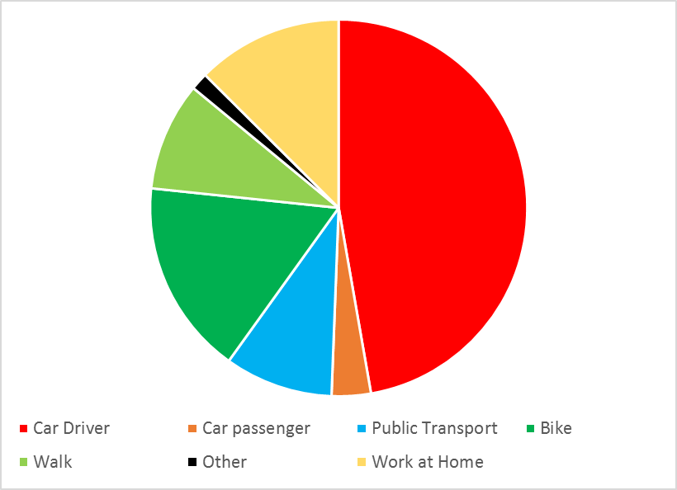
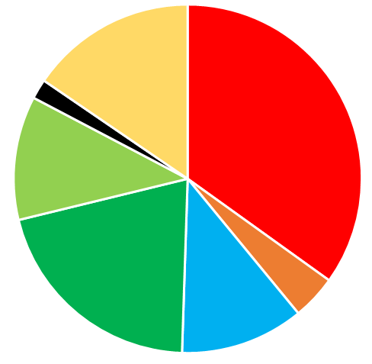
Modal shift - cars to alternatives
Notes:
These are our calculations of the mode shift required to get us to 2031 with a 10-15% reduction in car traffic in the city centre over 2011 levels
Given population and economic growth will drive trip generation up by some 20%, this implies 30-35% fewer car trips which is, of course, ambitious
To achieve this, we need to reduce mode share by car (driver + passenger) from 50% (2011) to 39% in 2031
Active travel modes rise from 30% to 33% (note we already have the highest number of cycling trips in the country) . Investment from companies like OfO in privately provided bike share shows confidence in Cambridge to continue to drive up cycle mode share.
Public transport increases from 9% to 11%
Work from home also increases from 13% to 15% as people’s working habits change

Slide 7
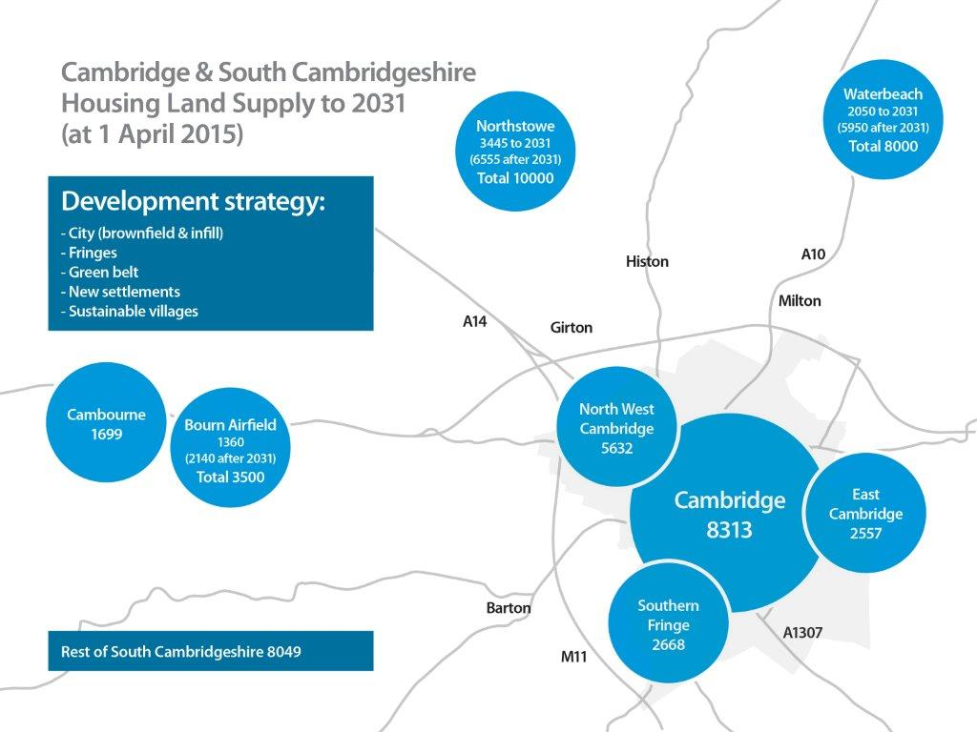
Housing

Slide 8
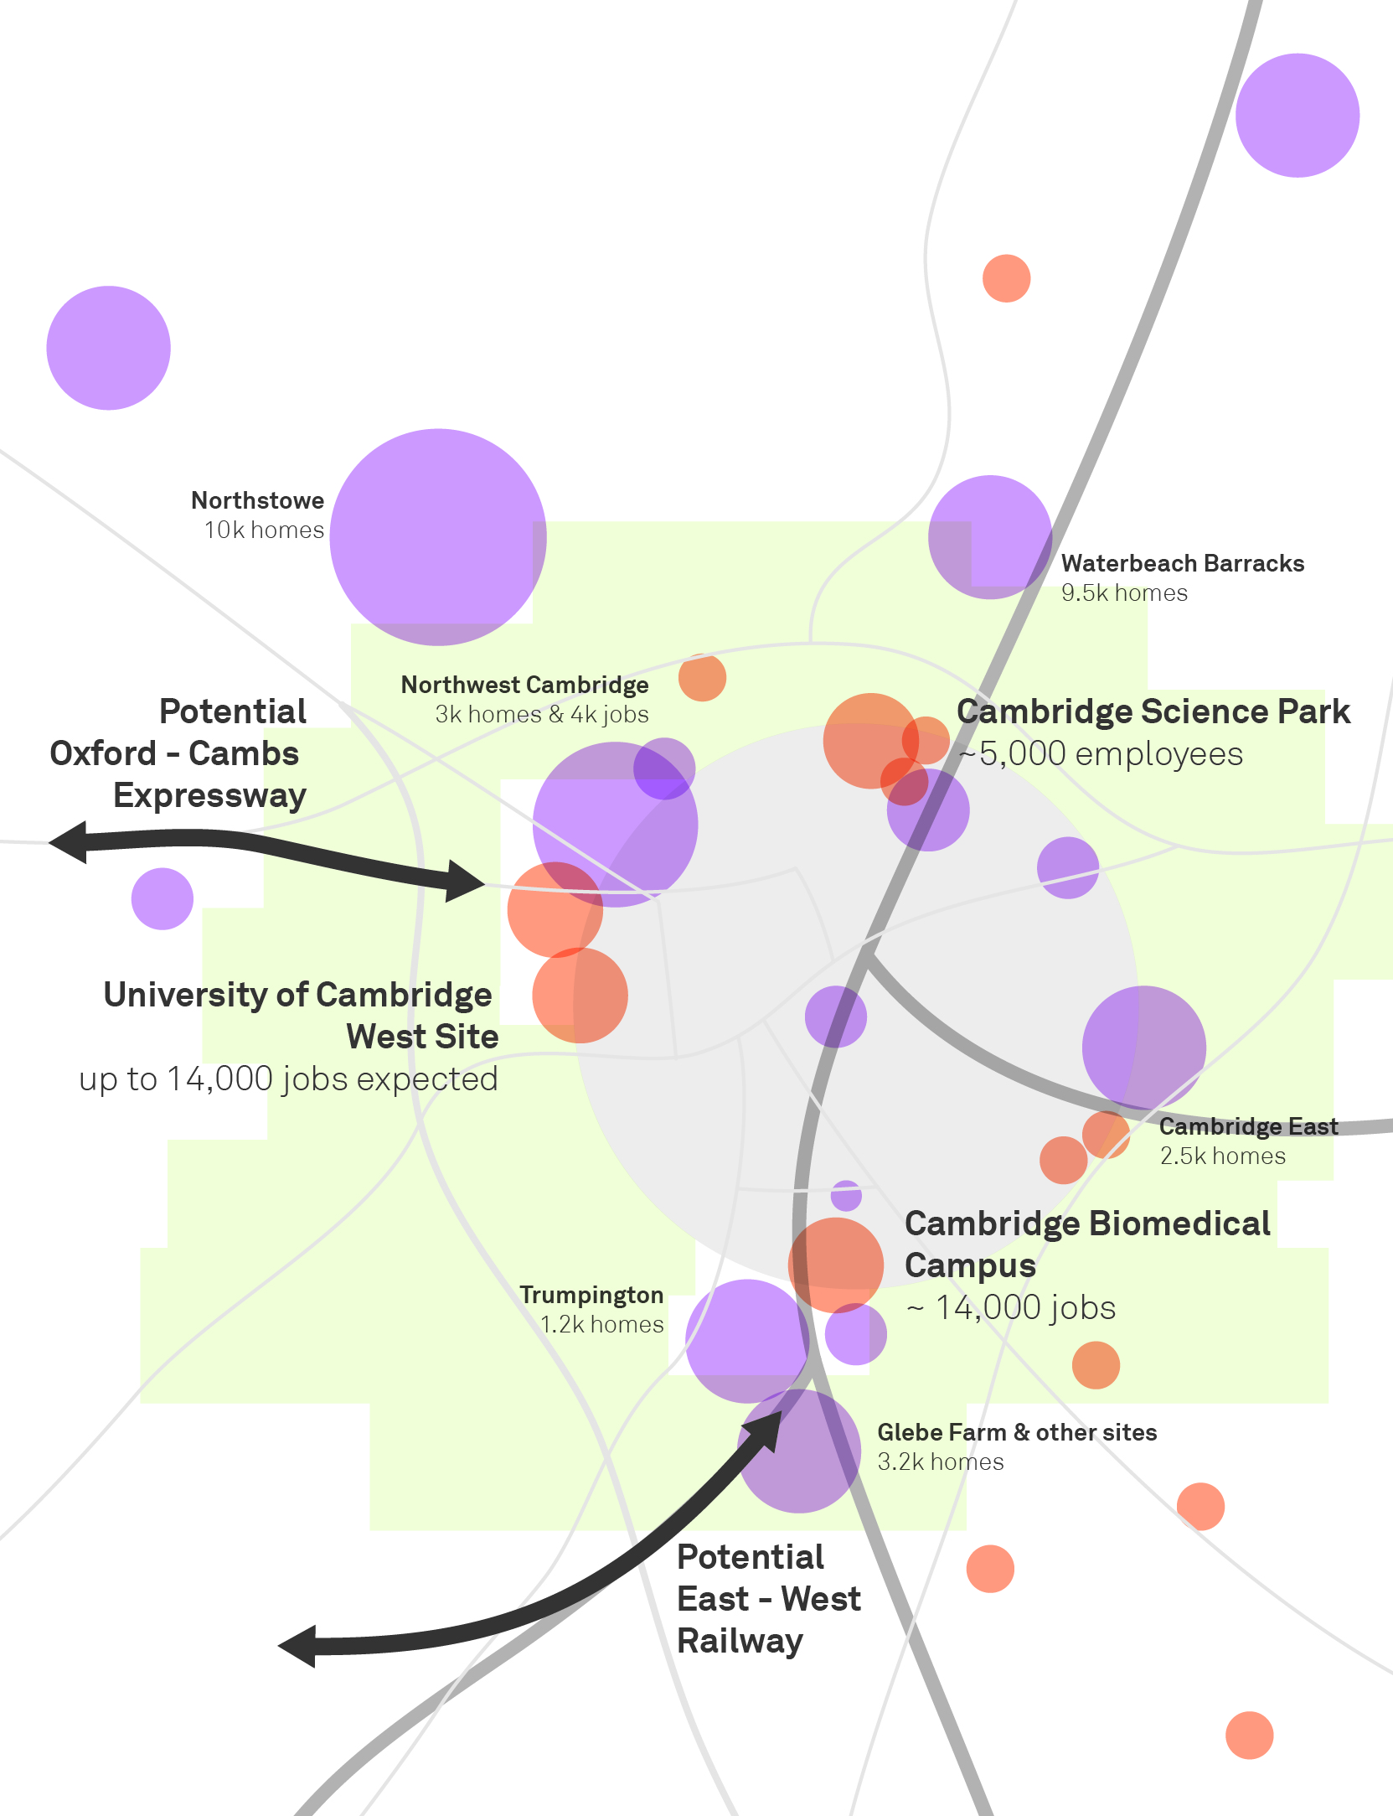
Cambridge: growth and investment
Notes:
Established firms are expanding or relocating to Cambridge
University and anchor firms are driving a large rate of start-ups and scale-ups
33k new jobs are expected to be delivered across just 3 key sites over the next few years
We have ambitious plans for growth: XXX homes and XXX jobs by 2031, supported by a non statutory combined spatial plan and joint local transport strategy
We have negotiated a city deal with central government as well as growth funding for the wider area which will allow us to deliver on these growth commitments

Slide 9
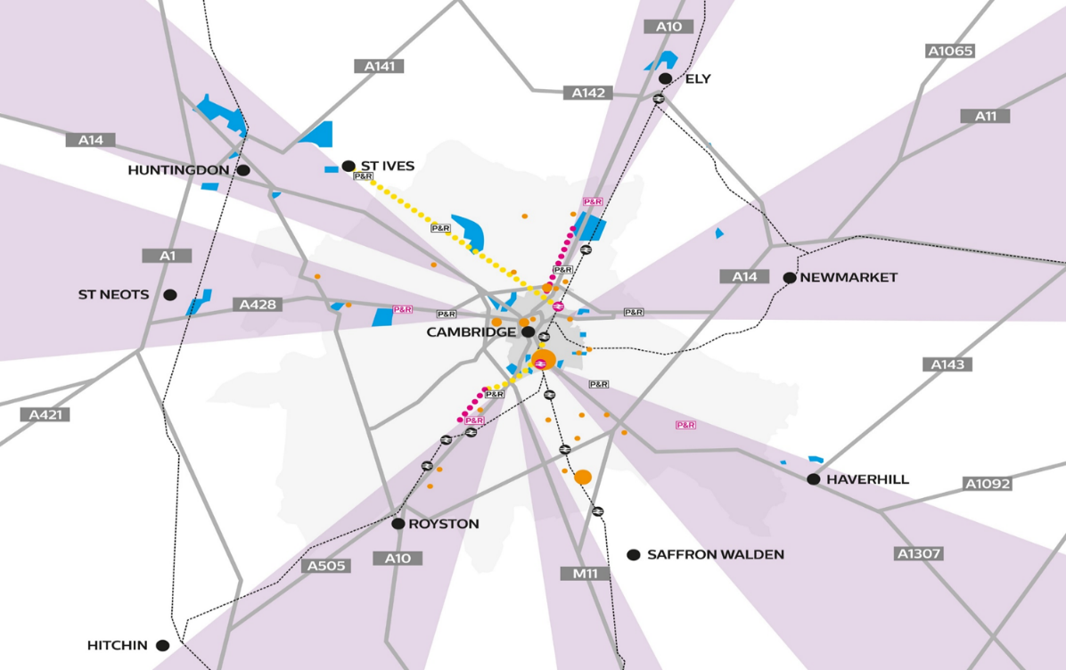
RAF Whitton to be removed?
Notes:
Seven corridors of growth and connectivity which support agglomeration and clustering in Cambridge
Creating connections for these corridors will unlock housing and development that the centre cannot take on its own
Cambridge has a 360º relationship with it’s hinterland – it’s not merely the end point of the Oxford to Cambridge corridor – it has functional economic relationships in all directions and growth aspirations reflect that.

Slide 10
Cambridge Rapid Mass Transit
Options Appraisal
‘Cambridgeshire Autonomous Metro’ (CAM): The Proposition
Greater Cambridge Partnership
and
Cambridgeshire and Peterborough Combined Authority

Slide 11
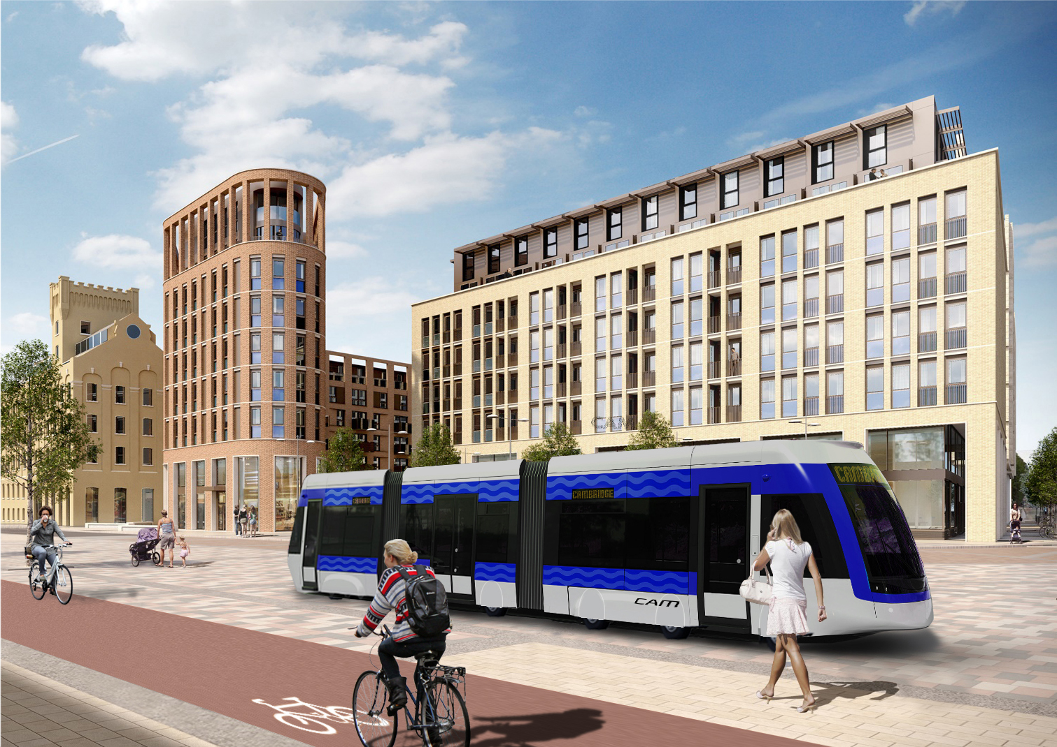
CAM - Cam Metro - the vision
Project being led by the Mayor/Combined Authority

Slide 12
Principles of a mass transit solution
Liberates city centres from cars
Deprioritises private car
Rapid (almost certainly segregated)
Capacity of xx (analysis of required capacity underway)
Incorporates park and ride elements
Integrated
Physically: with existing transport networks, East West Rail and the Expressway
Information: including RTI
Ticketing: mobility as a service (Maas) principles
Flexible
To changing spatial patterns of growth
To changing travel behaviours and demand levels
Many points to connect
Links existing homes and jobs
Links businesses and universities to one another (supporting knowledge spillovers)
Supports housing and employment delivery
Spreads economic success beyond the corridor – 360º connectivity of the 3 key modes in the corridor
Incorporates digital connectivity
Affordable, feasible
Notes:
This is what we want our mass rapid transit solution to deliver
At the moment, our feeling is that AVRT offers most potential to deliver these objectives at an affordable price
Other solutions, including light rail, are also being considered
They have many common elements, including the need to support growth beyond the greenbelt and the likely need to tunnel in the city centre
We have commissioned an independent study to consider which mass rapid transit solution to take forward

Slide 13
Shortlisted Options
Option | Description - Infrastructure | Service coverage | Capital Cost (indicative)
LRT City Network | 42km new infrastructure Based on Cambridge Connect proposals | 42km network Corridors served via P&R, bus feeders | £2.8bn
LRT Regional Network | 90km new infrastructure Based on Cambridge Connect proposals | 90km network Direct service to hinterland locations | £4.5bn
AVRT City Network | 15km new infrastructure Based on John Miles’ proposal Single or twin bore | 15km network Corridors served via P&R, bus feeders | £1.1 - £1.7bn
AVRT Regional Network | 56km new infrastructure Based on John Miles’ proposal Twin-bore to provide required capacity | 56km network Direct service to hinterland locations | £2.1bn
Cambridgeshire Autonomous Metro (CAM) | 42km new infrastructure, of which: 16km new segregated infrastructure in Cambridge (inc. tunnel) 25km of planned / proposed segregated links under City Deal Flexible services, so could serve regional network | Support services across full regional network (i.e. 90km +) Direct service to hinterland locations | £1.5 - £1.7bn

Slide 14
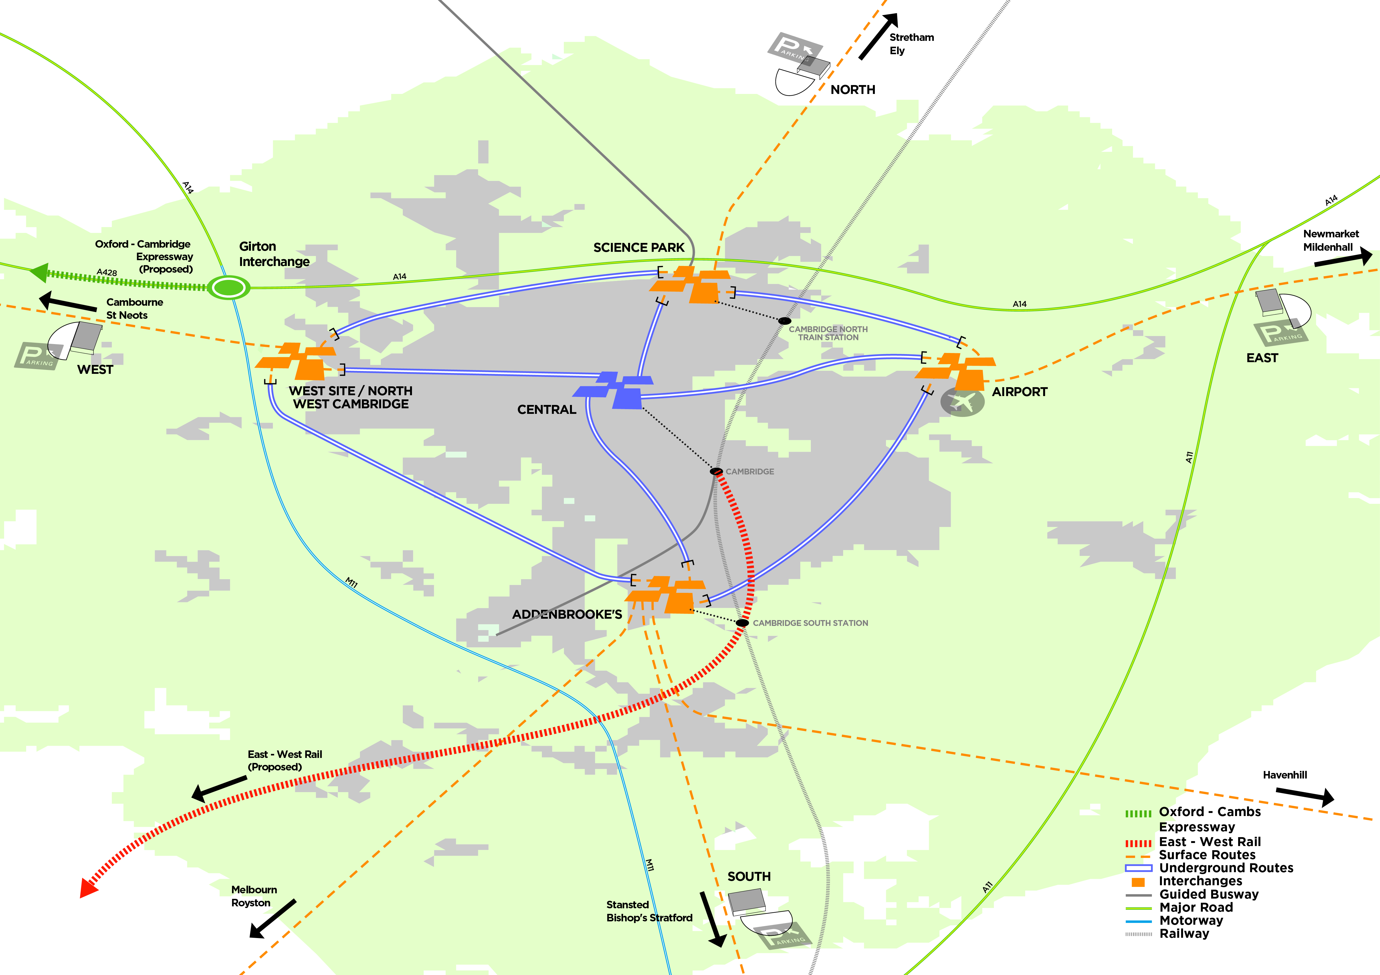
Notes:
This is a schematic representation of a mass rapid transit scheme for Cambridge, which maximises the benefits of existing north-south connectivity and proposed East West improvements
The network is conceptual and indicative
It would be designed around the eventual east-west connectivity solution(s), to seamlessly integrate
It is based on the premise of an AVRT network, but the concept would hold with a more traditional light rail solution
It should seamlessly integrate the city-centre with the key out of town employment nodes (north, south, east, west)
It should incorporate park and ride facilities
It should allow movement around the city centre, probably underground
This solution works with either a high speed or a metro service East West rail – but a truly integrated AVRT type system across the corridor could help to manage the trade-offs between speed and housing delivery. Interchange must be seamless. Ticketing, signage. Familiarity will make people inclined to use it across the network.
We think this is the right solution for Cambridge irrespective of the Oxford to Cambridge corridor, but the two together could be really transformational
Two key points of intersection with the CaMKOx corridor are Girton (expressway) and Cambridge South (East West Rail) – we will come back to these
Big advantage of this scheme is that the outlying spurs (the orange, at grade branches) can be flexible to future development opportunities
It allows Cambridge to grow by a) a step change in reducing car traffic in the city centre, b) allowing development out of town without compromising greenbelt, which is important to Cambridge’s environment and quality of life
Cambridge keen to be a pioneer in a potential national solution (to the problem of congestion in smaller cities which are unlikely ever to have the patronage needed to support a more traditional metro network)
The ask is – fund this across three cities. Risks and development costs can then be shared. We will play our part but looking to NIC to support our proposition to government that they should part fund feasibility studies and further development (subject to the conclusions of our independent review).

Slide 15
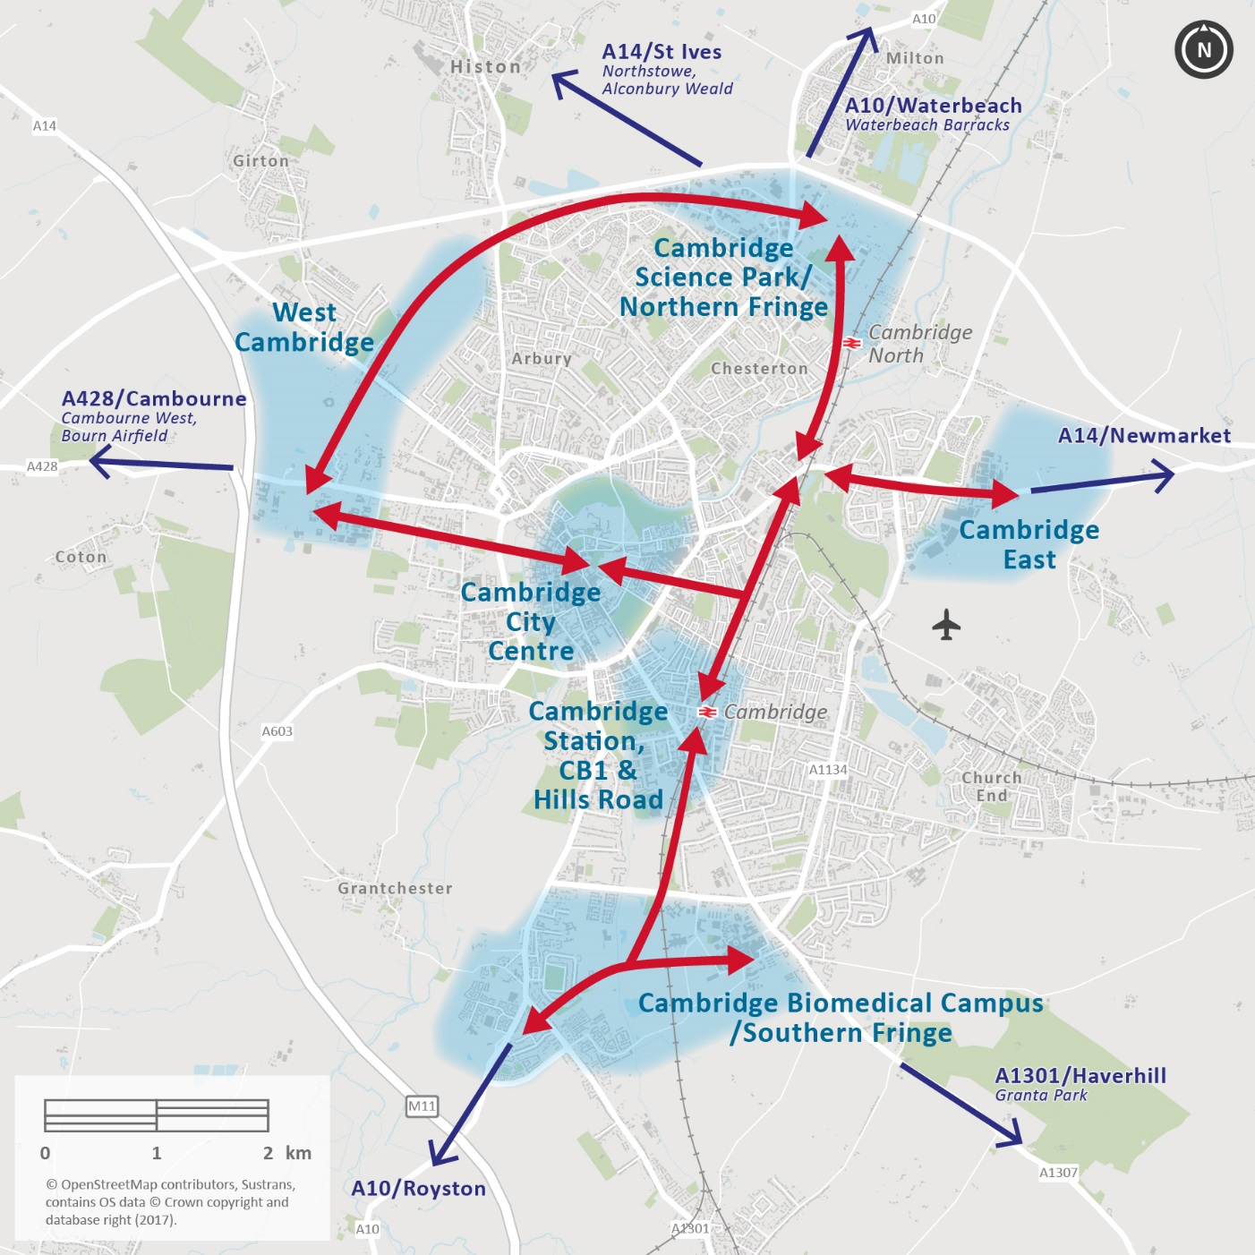
Network of connectivity
Connects all key destinations and development sites to one other and to radial corridors

Slide 16
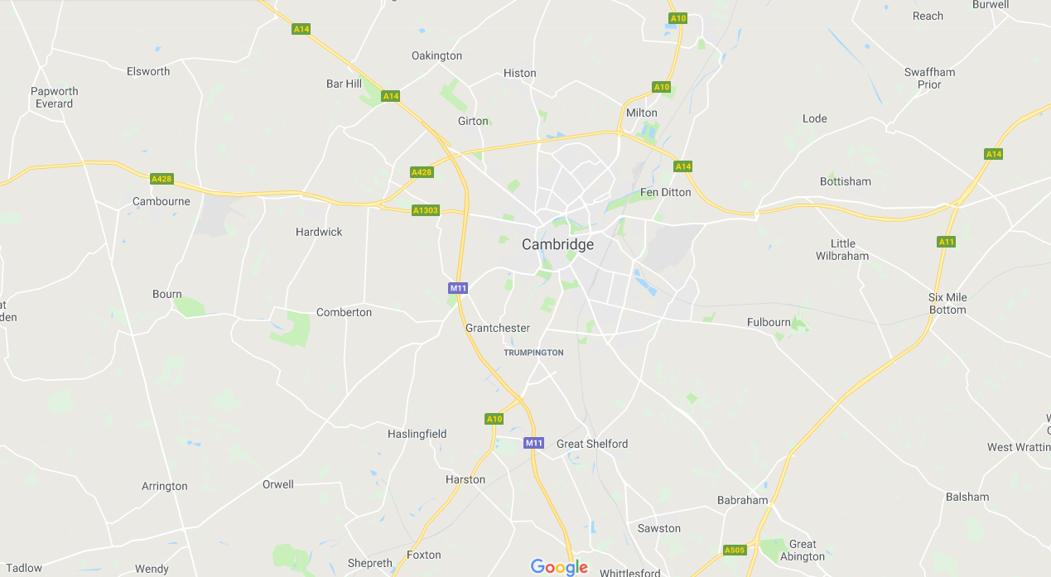
CAM: Network Schematic (infrastructure)
To St Ives
L
E
D
G
K
C
F
A
B
H
I
Existing busways
Proposed new public transport routes (for bus or Metro)
New metro routes
Tunnelling
J

Slide 17
Transport Benefits Assessment
 | LRT - City | LRT – Regional Network | AVRT - City | AVRT - Regional | CAM | Comment
Network coverage | ✓✓ | ✓✓✓ | ✓ | ✓✓ | ✓✓✓✓ | CAM offers widest potential service coverage, across all radial corridors. LRT city network provides good coverage, but only within the city area. LRT regional network would serve radial corridors, but not those to the north (e.g. Huntingdon / Waterbeach), where interchange would be required with existing / proposed bus services. AVRT would serve four radial corridors. AVRT city network coverage is more limited that other options.
Route flexibility | ✓ | ✓ | ✓ | ✓ | ✓✓✓ | CAM provides for greater route flexibility through its ability to operate on existing segregated and on-street infrastructure. LRT and AVRT networks could be developed incrementally, but network expansion would incur significant capital costs and higher deliverability risk than the more limited infrastructure required for CAM. In absence of bespoke fixed infrastructure bus feeder services could link to LRT and AVRT hubs.
Frequency | ✓ | ✓ | ✓✓✓ | ✓✓✓ | ✓✓ | All options would operate at an attractive service level: AVRT would operate at highest frequency of options to serve expected demand, as the vehicle capacity is lower. Higher capacity of LRT means that fewer vehicles per hour likely to operate compared to CAM.
Journey time / reliability (in-vehicle) | ✓✓ | ✓✓ | ✓✓✓✓ | ✓✓✓✓ | ✓✓ | All options would provide attractive journey times, due to segregation of key sections of route from general traffic. AVRT is fully segregated and would have a faster in-vehicle time. LRT and CAM would both offer significant journey time savings over current provision.
Interchange (minimised) | ✓✓ | ✓✓✓ | ✓ | ✓ | ✓✓✓✓ | Interchange is unattractive from a user perspective. CAM would provide the greatest opportunity for direct services, to and across the city, both due to a more expansive network and smaller vehicle sizes. LRT would provide direct access to the city centre and for some cross-city movements. The LRT city network would require interchange from ‘feeder’ corridors. AVRT involved potentially multiple interchanges for some movements (any that are not directly between the two stations at either end of each tunnel)
Accessibility (no. stops served) | ✓✓ | ✓✓ | ✓ | ✓ | ✓✓ | AVRT offers poor overall direct accessibility (i.e. without interchange), and the network comprises only one city centre station and four on the city periphery. Other options provide for good levels of accessibility.
Quality | ✓✓✓ | ✓✓✓ | ✓✓ | ✓✓ | ✓✓✓ | LRT would, likely, offer a more attractive ride quality than the other modes. CAM would provide a higher quality offer than existing bus provision, through a higher quality vehicle, stops and information provision. AVRT quality is uncertain – it would operate at very high speed and this may compromise passenger comfort.
27/02/2018

Slide 18
Summary of Options Assessment
Feature | LRT | AVRT | CAM | Benefits of CAM
Connectivity | ✓✓ | ✓ | ✓✓✓ | Delivers maximum connectivity within Cambridge, to major ‘city fringe’ employment centres, satellite centres and market towns
Capacity | ✓✓✓ | ✓✓ | ✓✓✓ | Provides capacity and coverage to support growth
Quality | ✓✓✓ | ✓✓ | ✓✓✓ | Segregated routes and high-quality vehicles will benefit passengers and encourage significant modal-shift from car
Flexible and scalable | ✓ | ✓ | ✓✓✓ | Can be planned on basis of automated vehicles, and systems allowing for platooning (capacity) and network management (system optimisation and efficiency) Concept allows flexible operation to support growth over time Operation efficiency through optimising service levels and demand / capacity by corridor, time-period etc.
Value for Money | X | X | ✓✓ | Most cost-effective means of delivering connectivity, quality and capacity outputs, by making best use of existing and planned infrastructure and taking advantage of opportunities from rapidly advancing technology Most likely meet criteria for, and secure, Government funding contribution
Affordable | X | ? | ✓✓ | Likely to deliver an operational surplus i.e. not require ongoing subsidy
Deliverable | ✓ | X | ✓✓ | Elements of proposition can be implemented within next 5 years Delivery of full concept would be quicker than for other options considered

Slide 19
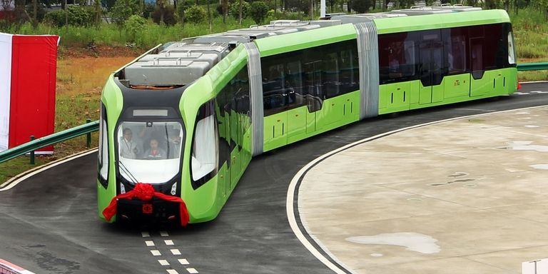
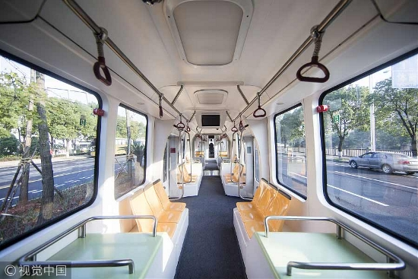
CAM: Indicative vehicle and features
High capacity and frequency
  Capacity to support future growth in Cambridge
  Reduced headways and fleet optimisation
Electric vehicles
  Battery operated and charge-at-stop
Proven technology
  Already operating elsewhere
Autonomous capable
  Can operate with a driver initially until autonomous technology matures
  Automation using on-board sensors
  No requirement for rails or physical guidance
  Platooning of vehicles
Branding
  Centrepiece of a Cambridge transport ‘brand’ integrated with other modes.

Slide 20
Funding mechanisms
CAM could be funded through a combination of:
Existing mechanisms:
    Community Infrastructure Levy
    Business Rate Supplement
    Council Tax Precept
    Local tax retention
Innovative funding:
  More flexible approaches to existing land-value capture mechanisms, as proposed by National Infrastructure Commission in November 2017, including:
    a city-regional CIL and/or pooling of Section 106 agreements
    ability to forward-fund infrastructure by borrowing against future receipts
  Wholly new land-value capture mechanisms, which fully address the “significant weaknesses” of current mechanisms identified by the National Infrastructure Commission, if developed through primary legislation
Central Government funding through existing funding streams
  E.g. Large Local Major Schemes (DfT), Housing Infrastructure Fund (DCLG)
    Workplace parking levy or dynamic charging regime
    Highways England Contribution
    Direct contributions

Slide 21
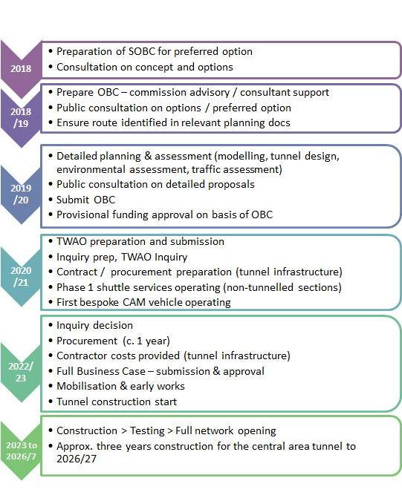
Delivery timescales
Phase 1 in 2021:
  Bespoke CAM vehicles delivered to Cambridge
  Adaptation of guideway for autonomous operation
  Initial shuttle service operating between Biomedical Campus and Cambridge Station
Through services via tunnel in 2026/27

Slide 22
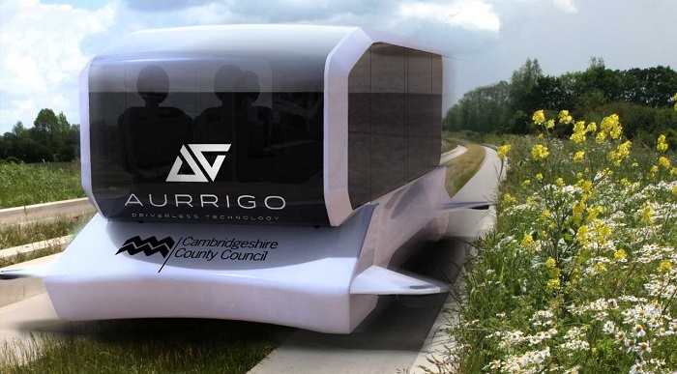
Autonomous Vehicle Trial
6 vehicles for 10-15 on Station/Addenbrookes/Cambridge South busway enabled by Government £3.2m CCAV-3 funding.
Part of the “Smart Cambridge” programme http://smartcambridge.org/

Slide 23
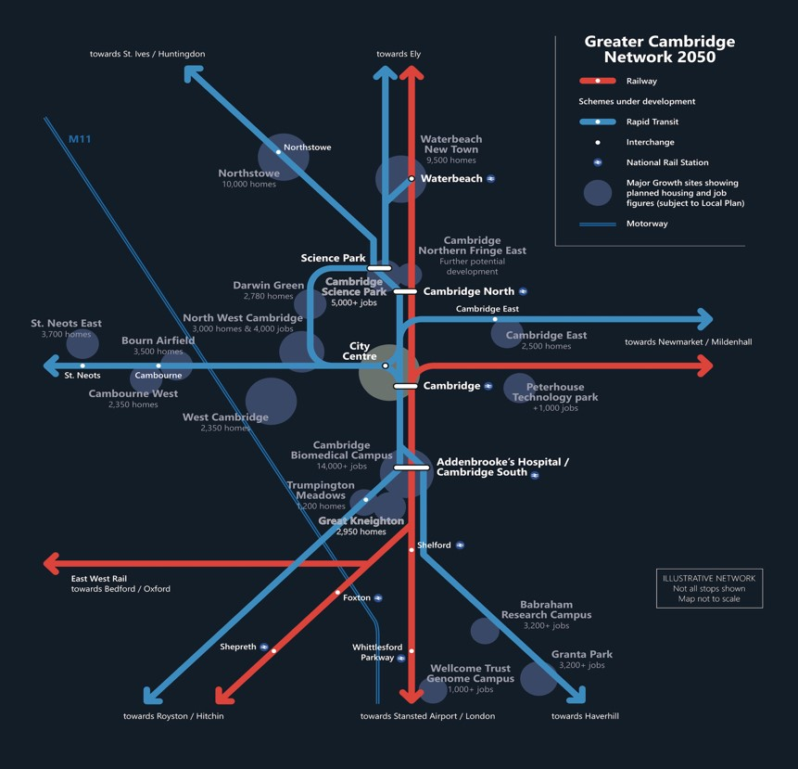

Slide 24
How Can Historic Cities Grow Sustainably?
- The Need For Cambridge Rapid Mass Transit
Councillor Lewis Herbert, Leader - Cambridge City Council
Portfolio Holder - Strategic Planning, C&P Combined Authority
and Vice-Chair, Greater Cambridge Partnership (City Deal)

